Slide 1
Introduction
Lecturer: Meng Duc Bui Tien (Mr.)

Slide 2
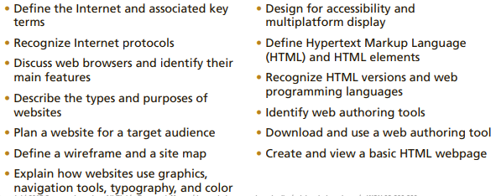
Introduction to the Internet and Web Design
Objectives

Slide 3
Introduction to the Internet and Web Design
Introduction
Today, millions of people worldwide have access to the Internet, the world’s largest network.
Billions of webpages providing information on any subject you can imagine are currently available on the web

Slide 4
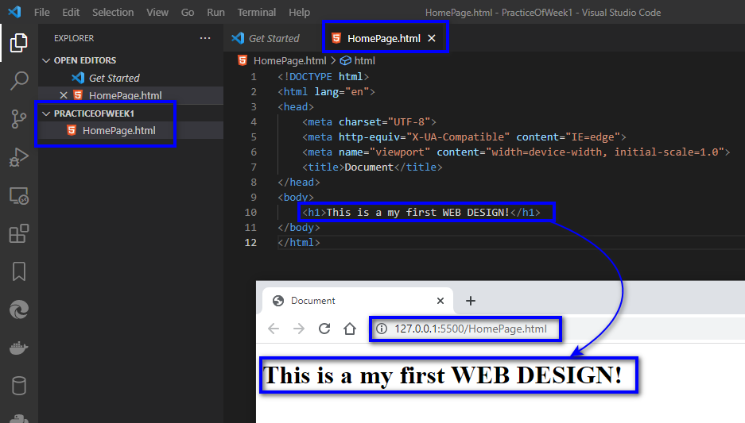
Introduction to the Internet and Web Design
Project — Create a Basic Webpage

Slide 5
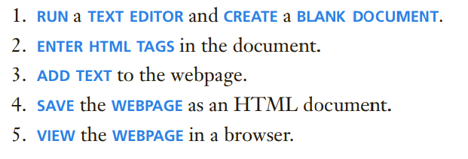
Introduction to the Internet and Web Design
Roadmap

Slide 6
Introduction to the Internet and Web Design
World Wide Web
The World Wide Web, also called the web, is the service that
provides access to information stored on web servers, the high-capacity, high-performance computers that power the web. The web consists of a collection of linked files known as webpages, or pages for short.
- Because the web supports text, graphics, audio, and video, a webpage can display any of these multimedia elements in a browser.
A website, or site for short, is a related collection of webpages created and maintained by a person

Slide 7
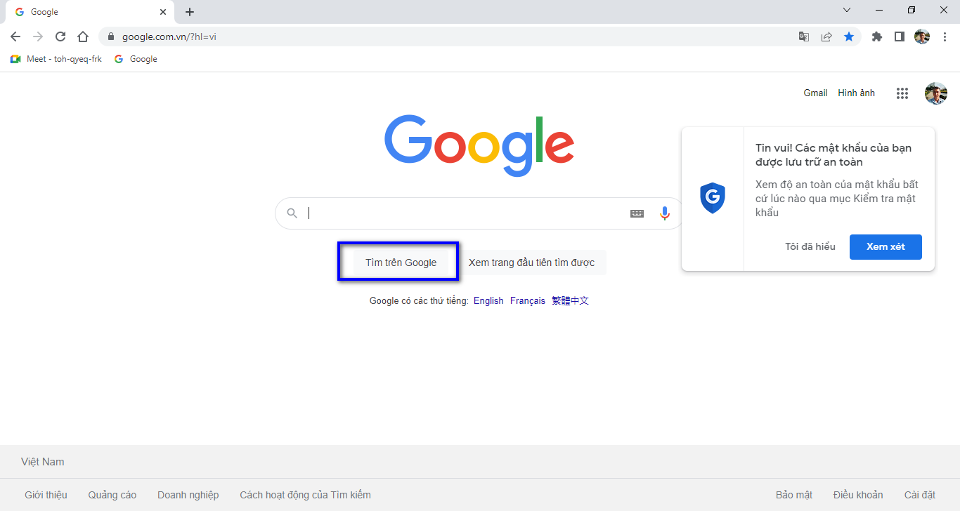
Introduction to the Internet and Web Design
World Wide Web

Slide 8
Introduction to the Internet and Web Design
Protocols
- A computer is also referred to as a client workstation. Client workstations connect to the Internet through the use of a protocol. A protocol is a set of rules that defines how a client workstation can communicate with a server. A client workstation uses a protocol to request a connection to a server. The server is the host computer
that stores resources and files for websites

Slide 9
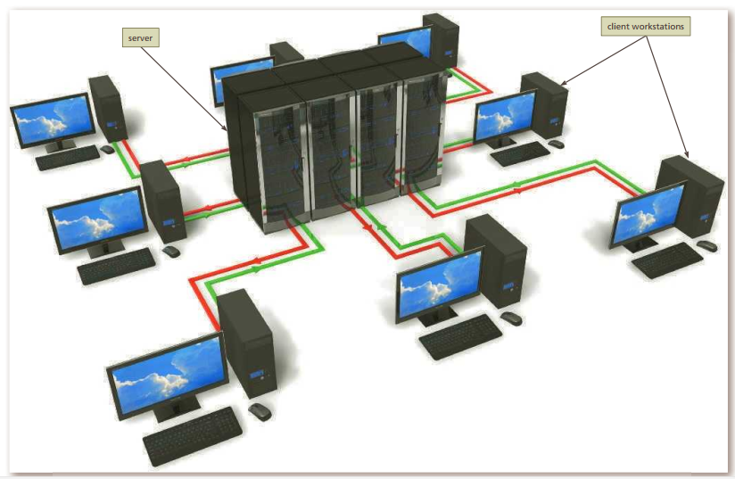
Introduction to the Internet and Web Design
Protocols

Slide 10
Introduction to the Internet and Web Design
Protocols
Hypertext Transfer Protocol (HTTP) is the fundamental protocol used on the web to exchange and transfer webpages. HTTP is a set of rules for exchanging text, graphics, audio, video, and other multimedia files on the web.
HTTP to connect to the server containing the page which want to view, and then to request and display the appropriate page.
Internet Protocol (IP) ensures data is sent to the correct location

Slide 11
Introduction to the Internet and Web Design
Web Browsers
- To access a website and display a webpage, a computer, tablet, or mobile device must have a web browser.
A web browser, also called a browser, is a program that interprets and displays webpages so you can view and interact with them.
Computing devices such as smartphones, tablets, laptops, and desktops include their own default browser, but we also have the option to download and use the browser of our choice (Microsoft Internet Explorer, Mozilla Firefox, Google Chrome, Apple Safari, and Opera)

Slide 12
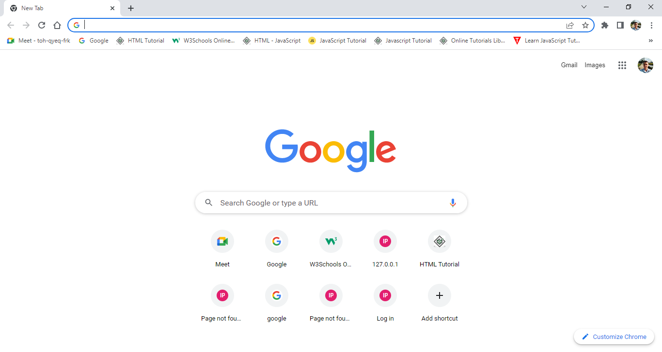
Introduction to the Internet and Web Design
Web Browsers

Slide 13
Planning a Website
Purpose of the Website: The purpose of a commercial business website is related to the goal of selling products or services
Target Audience: who will use the website
Multiplatform Display: users can access a website with computing devices ranging from desktop computers to laptops, tablets, and smartphones
Wireframe: Before web designers actually start creating the first webpage for a website, they sketch the design using a wireframe. A wireframe is a simple, visual guide that clearly identifies the location of main webpage elements, such as the navigation area, organization logo, content areas, and images

Slide 14
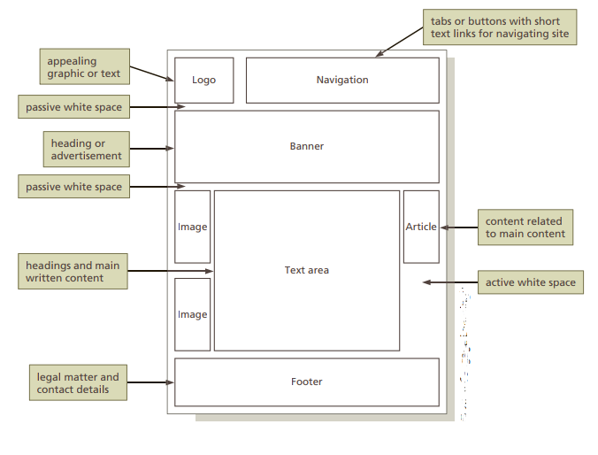
Planning a Website
Wireframe:

Slide 15
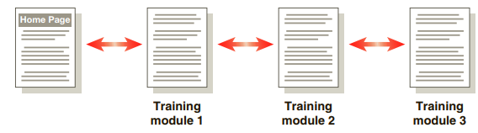
Planning a Website
Site Map: A site map is a planning tool that lists or displays all the pages on a website and indicates how they are related to each other

Slide 16
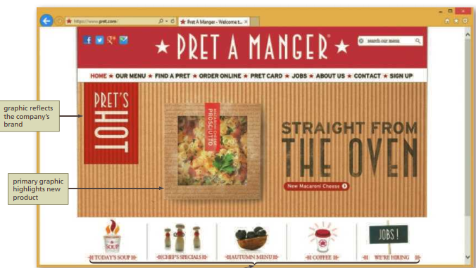
Planning a Website
Graphics: Graphics add visual appeal to a webpage and enhance the visitor’s perception of your products and services

Slide 17
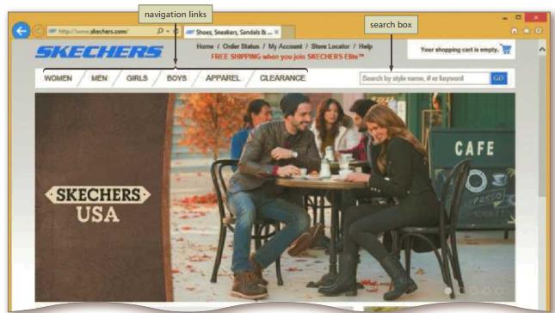
Planning a Website
Navigation: As mentioned previously, the navigation of your website should be clear and concise

Slide 18
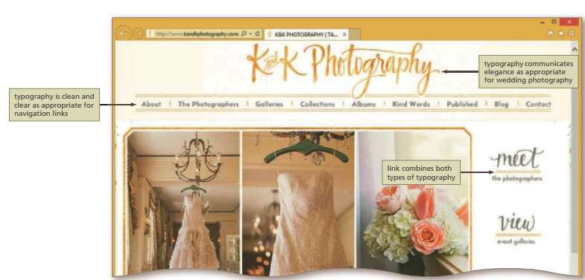
Planning a Website
Typography: The use of effective typography, or fonts and font styles, enhances the visual appeal of a website

Slide 19
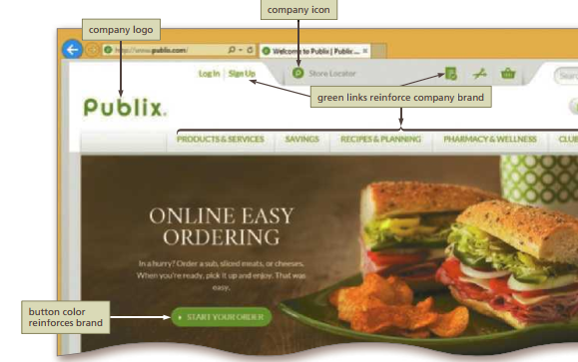
Planning a Website
Color: All websites use color, even if the colors are black and white. Select a limited number of coordinated colors that help promote your purpose and brand

Slide 20
Planning a Website
Accessibility: address accessibility and localization issues. A web designer should create pages for viewing by a diverse audience, including people with physical impairments and global users.
Planning Checklist: The planning items just discussed are only a few of the basic webpage design issues that you need to consider when developing a website

Slide 21
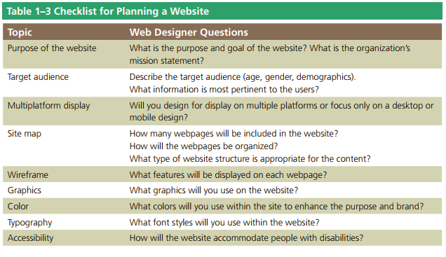
Planning a Website
Planning Checklist:

Slide 22
Web Publishing
Uniform Resource Locators:
The URL provides a universal, consistent method for finding and accessing information. In addition to typing URLs directly into your browser to go to a particular page.
We also use URLs when we create a hypertext link within a document to another document. So, any way you look at it, URLs are important to how we and our browser get around on the Web.

Slide 23
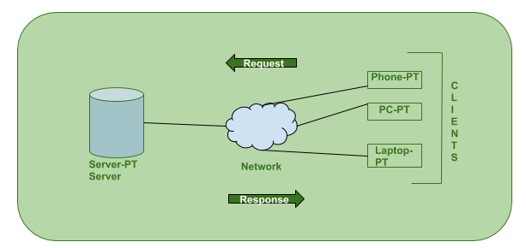
Web Publishing
Web Servers: To view and browse pages on the Web, all we need is a web browser. To publish pages on the Web, we need a web server
A web server is the program that runs on a computer and is responsible for replying to web browser requests for whatever content is associated with a particular URL. We need a web server to publish documents on the Web

Slide 24
Web Publishing
Web Hosting:
- At some point, we’ll want to move the websites our create from our local computer to a server on the Internet. Before doing so, we must decide exactly what kind of hosting arrangement you want. The simplest approach is to get a web hosting account that enables us to upload our HTML files, images, style sheets, and other web content to a server that’s visible on the Web. This approach enables we to easily create web pages
(and websites) locally and publish them on the server without making changes to them.

Slide 25

Web Publishing
Web Hosting:

Slide 26
Web Publishing
The domain name system (DNS) is a naming database in which internet domain names are located and translated into Internet Protocol (IP) addresses. The domain name system maps the name people use to locate a website to the IP address that a computer uses to locate that website.

Slide 27
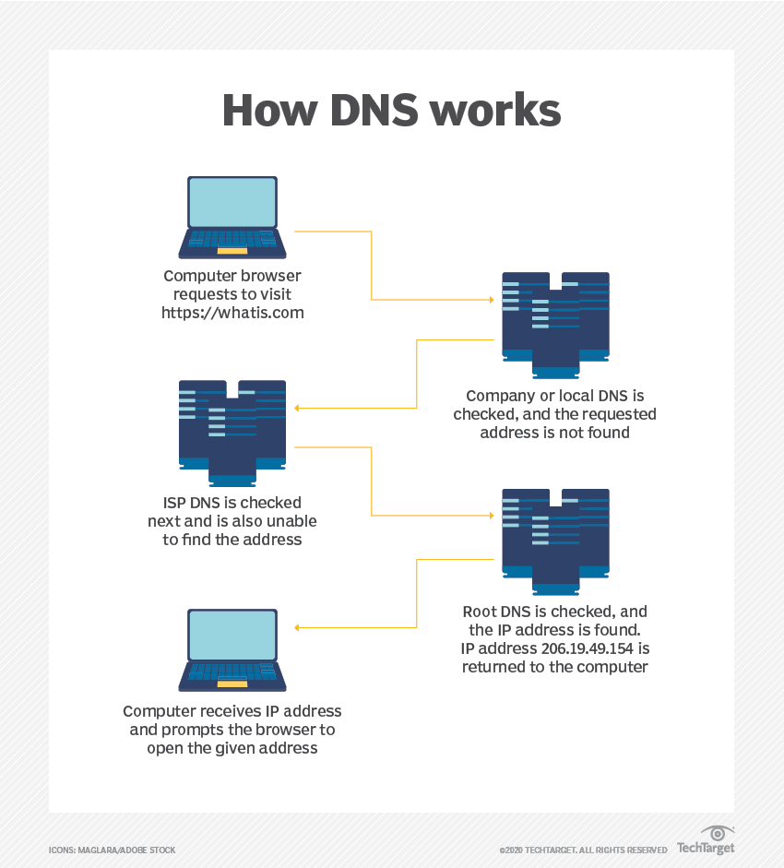
Web Publishing
The domain name system (DNS)

Slide 28
Web Publishing
Domain names: are a key part of the Internet infrastructure. They provide a human-readable address for any web server available on the Internet.
- Any Internet-connected computer can be reached through a public IP address, either an IPv4 address (e.g. 173.194.121.32) or an IPv6 address (e.g., 2027:0da8:8b73:0000:0000:8a2e:0370:1337).
- Computers can handle such addresses easily, but people have a hard time finding out who's running the server or what service the website offers. IP addresses are hard to remember and might change over time.

Slide 29
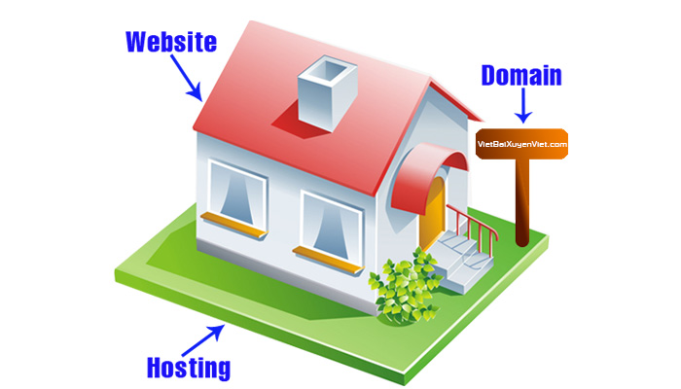
Web Publishing
Domain names:

Slide 30
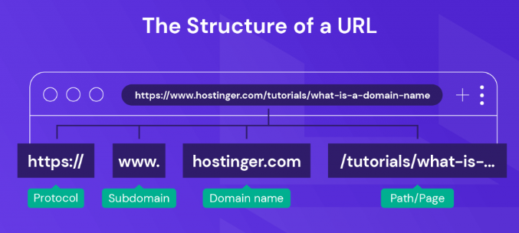
Web Publishing
Differences Between a Domain Name and a URL: While a domain name and a Universal Resource Locator (URL) share some similarities, they are different. A URL acts as a complete web address that can direct visitors to a specific page on a site. A domain name is just a part of it.

Slide 31
Web Publishing
How Do Domains Work? - Every website has two main elements – a domain name and a web hosting server. All domain names are linked to their respective IP addresses and point to the specific web servers that host the websites.
- When a user enters a domain name into a browser, it looks for the associated IP address through a global network of Domain Name System (DNS) servers. Next, the server with the information about the IP address return it to the web browser which requests data about the site from the domain’s hosting service. This web server stores all of the website’s data, including its files, database, and HTML code.
- Once the host has sent the data back, the web browser converts it into a web page that users can visit.

Slide 32
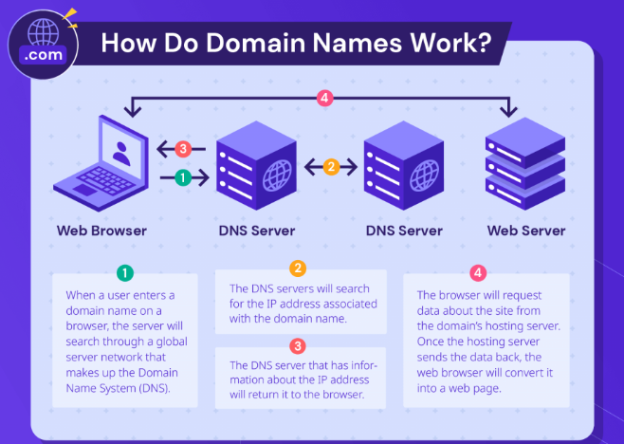
Web Publishing
How Do Domains Work

Slide 33


Slide 34
